Slide 1
Northeast Generation .2 Training
Diagram Review / Matrix

Slide 2
AUMA Wiring Diagrams
New Wiring Diagram Designation
SA.2 NORM
AC.1
AC.2
Dimensional Diagrams
Where to find wiring diagrams
Tagging Information

Slide 3
New wiring diagram designations
New wiring diagram designations

Slide 4
New wiring diagram designations
Current designation…..
KMS – SA.1 NORM actuator
MSP – actuator with AM controls
ACP – actuator with AC.1 controls
SD – actuator dimensional diagram
New designation…..
TPA – SA.2 NORM actuator
MSP – actuator with AM controls
TPC – actuator with AC.2 controls
ACP – actuator with AC.1 controls
DDS – actuator dimensional diagram

Slide 5
TPC – Terminal Plan Controls
 | AC2 | AM | AC1
Multi-turn
SA 07.2 – 16.2 | TPC TPA | MSP TPA | ACP TPA
SA 25.1 – 48.1 | TPC TPA | MSP TPA | ACP KMS TP
SA 07.1 – 16.1 | TPC KMS TP | MSP KMS TP | ACP KMS TP
Part-turn
SG 05.1 – 12.1 | TPC TPA | MSP TPA | ACP KMS TP

Slide 6
TPA wiring
Similar to KMS Wiring

Slide 7
SA.2 NORM
Diagrams

Slide 8
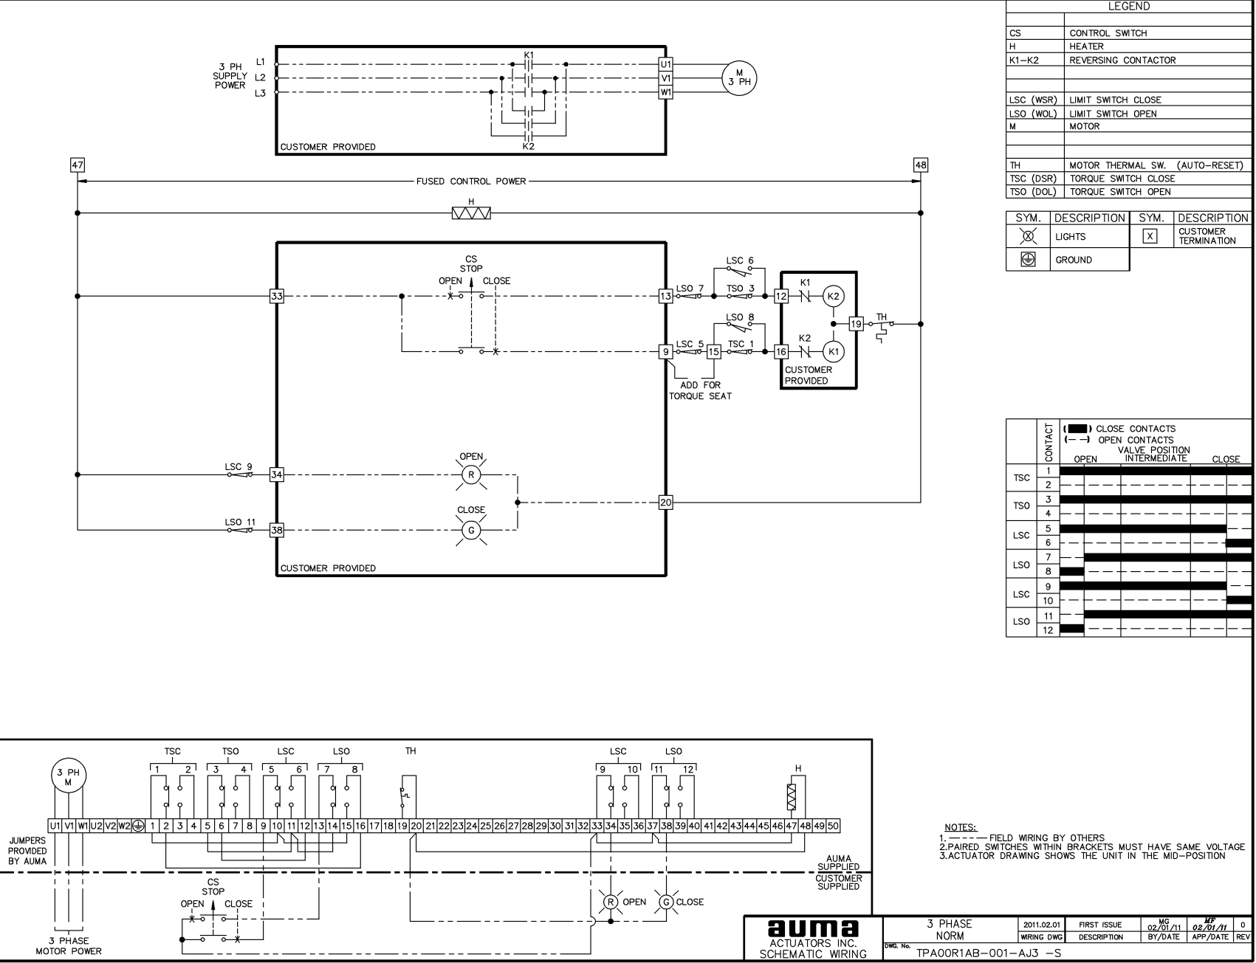
Norm SA.2 Wiring ( schematic )
Motor connections
Legend
External control connections

Slide 9
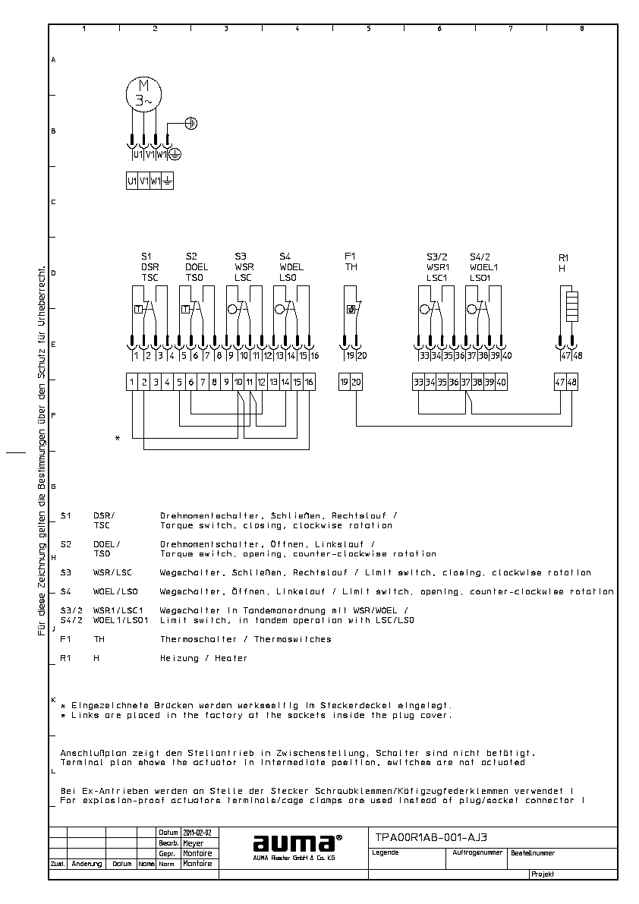
Norm SA.2 Wiring ( point to point )
Motor connections
External control connections
Legend

Slide 10
TPA Wiring diagram codes
KMS | TP 100/001 | TPA | 00R1AA-101-000
TPA: 00R1AA-101-000
new code
required due to new features
fully compatible to the old system (KMS)

Slide 11
TPA Code system
1 | 2 | 3 | 4 | 5 | 6 | 7 | 8 | 9 | 10 | 11 | 12 | 13 | 14
0 | 0 | R | 1 | A | A | - | 0 | 0 | 1 | - | 0 | 0 | 0
Reserved
Heater:1:=110-250V &24Vdc
2:= 380V-400V
Pos. Trans: 0:= w/o A:= Pot
E:=RWG; Q/I:=MWG
Motor
00→ AUMA 3ph
01→L. 1ph.
50→with AM/C
16→SG
Signalization: 1:= Blinker,
2:=BL+ Manual
Limit Switches: A:= 8; B:= 8.2
Torque Switches: A:= 6; B:= 6.2 Tandem Sw.
Motor protection: 1:= 1xTH; 2:= 1xPTC etc…
Closing direction: R:= CW; L:= CCW

Slide 12
KMS to TPA Comparison table
Old |  | New
IFAX |  | IFAX |  | Switches
KMS | 60TP or. 15 TP | TPA | 01…
KMS | 61TP or 26 TP | TPA | 02…
KMS | 62TP or 27 TP | TPA | 03…
KMS | TP100/001 | TPA | 00R1AA-001-000 | 6/8
KMS | TP200/001 | TPA | 00R2AA-101-000 | 6/8
KMS | TP104/001 | TPA | 00R1AA-0E1-000 | 6/8
KMS | TP140/001 | TPA | 00R1AA-0C1-000 | 6/8
KMS | TP180/001 | TPA | 00R1AA-0I1-000 | n/a
KMS | TP110/001 | TPA | 00R1AA-001-000 | 6/8
KMS | TP210/001 | TPA | 00R2AA-101-000 | 6/8
KMS | TP110/201 | TPA | 00R1AB-101-000 | 6/8.2
KMS | TP110/211 | TPA | 00R1AF-001-000 | 6.2/9
KMS | TP110/101 | TPA | 00R1AB-101-000 | 6.2/8
KMS | TP110/011 | TPA | 00R1AE-101-000 | 6/9
KMS | TP110/301 | TPA | 00R1BB-101-000 | 6.2/8.2

Slide 13
Actuator Wiring AC.1

Slide 14
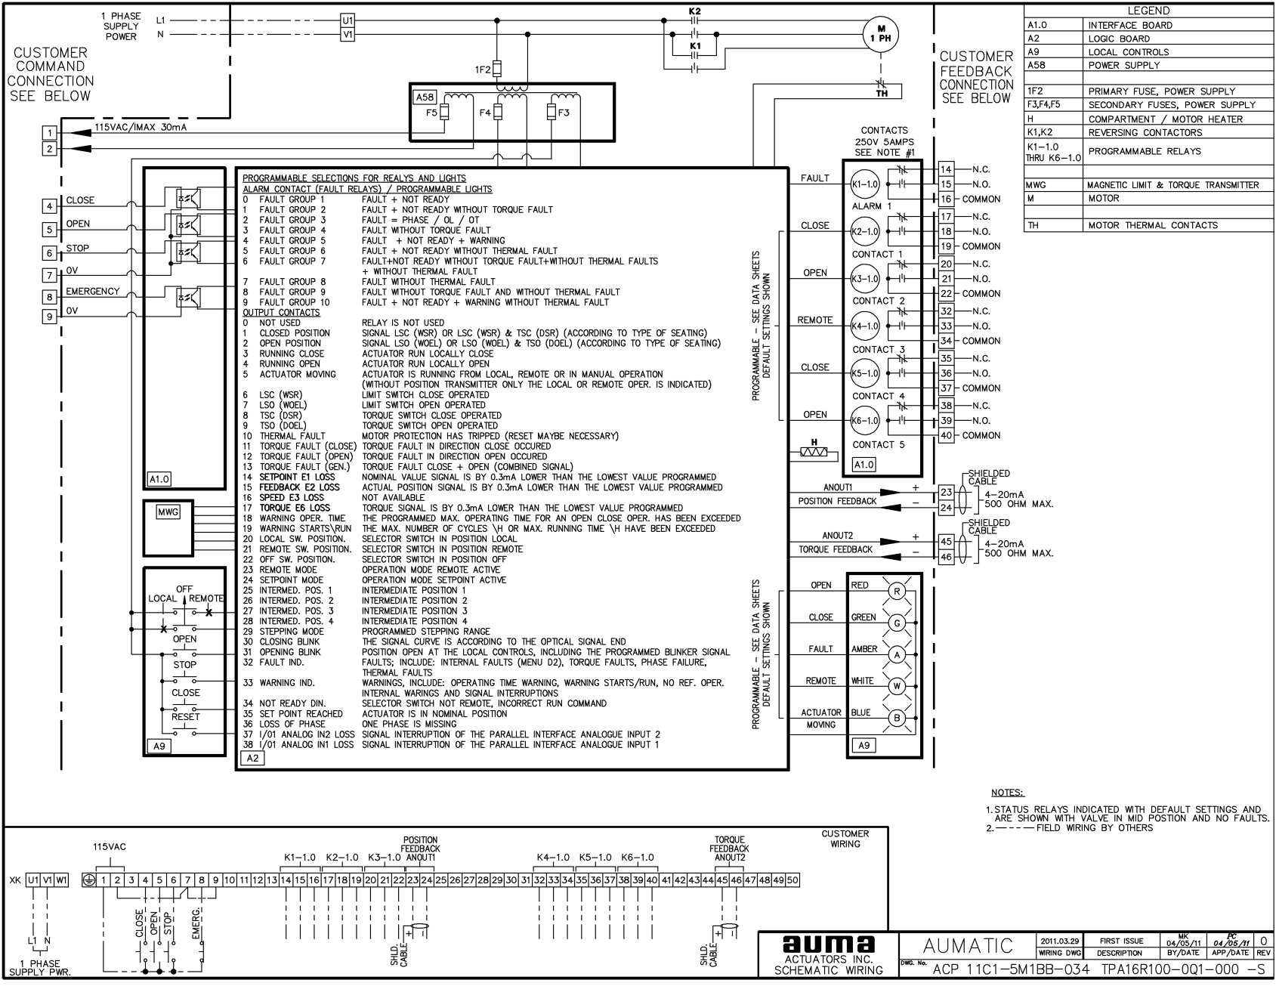
Typical ACP / TPA (AC.1 on SA.2) Drawing

Slide 15
Actuator Wiring AC.2

Slide 16
TPC numbering system
Digit | Meaning
1 | Type of controls
2 | Interface to DCS
3 | Analog inputs
4 | Digital inputs
5 | Remote indication: status contacts, position/torque feedback 0/4 – 20 mA
6 | Additional equipment
7 | Local controls
8 | Supply voltage: external supply 24 V DC/auxiliary voltage for controls/supply voltage tolerance
9 | Switchgear
10 | Motor protection options
11 | Heater
12-14 | Specials

Slide 17
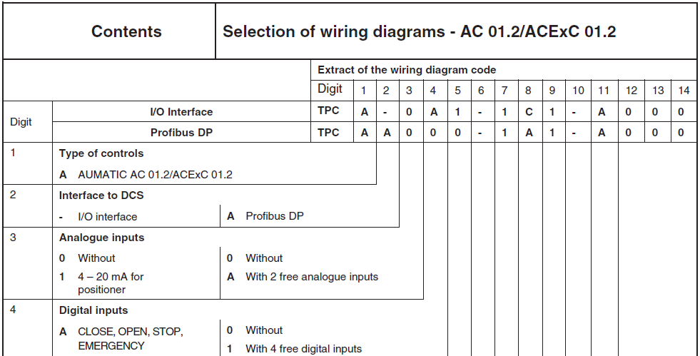
TPC numbering system
TPC - Terminal Plan Controls

Slide 18
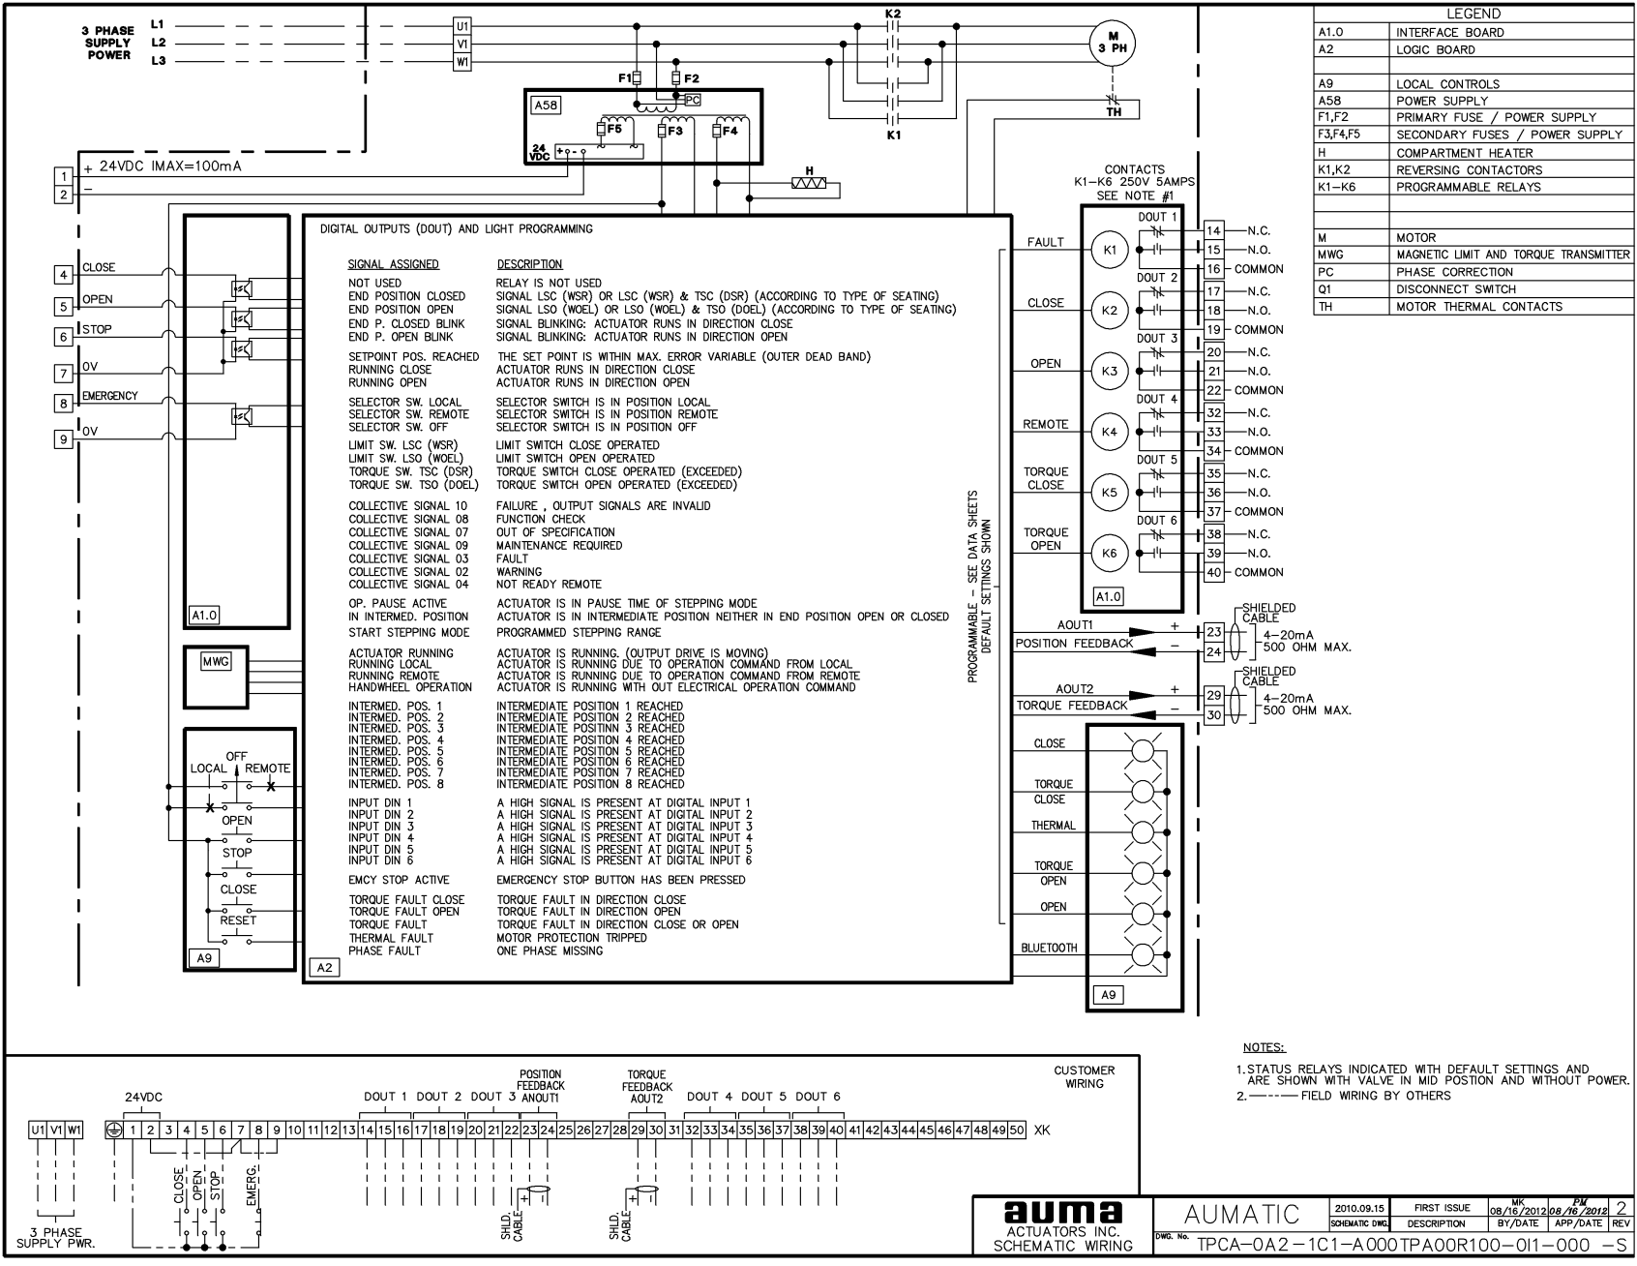
Typical TPA / TPC Wiring Diagram

Slide 19
TPC – Terminal Plan Controls
 | AC2 | AM | AC1
Multi-turn
SA 07.2 – 16.2 | TPC TPA | MSP TPA | ACP TPA
SA 25.1 – 48.1 | TPC TPA | MSP TPA | ACP KMS TP
SA 07.1 – 16.1 | TPC KMS TP | MSP KMS TP | ACP KMS TP
Part-turn
SG 05.1 – 12.1 | TPC TPA | MSP TPA | ACP KMS TP

Slide 20
MSP

Slide 21
Typical MSP / KMS Wiring Diagram

Slide 22
MSP – Customer connections
Supply power
Demand signal E¹
Auxiliary limit contacts
Feedback signal (position)
Selector switch status
Fault relay status
Control power
Remote command (mode)

Slide 23
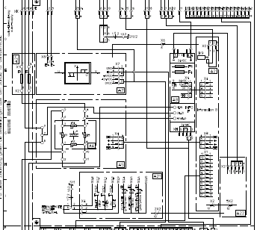
MSP – Control section
Refer to Drawing LEGEND for internal circuit board descriptions
Circuit board labels are present on drawing

Slide 24
MSP - Actuator terminals
Auxiliary limit contacts
Feedback signal (position)
Potentiometer
Motor Control circuit w thermal protection
Heater
Motor wires

Slide 25
New Dimensional Diagram Code System

Slide 26
DDS Code system
1 | 2 | 3 | 4 | 5 | 6 | 7 | 8 | 9 | 10 | 11 | 12 | 13 | 14
0 | 0 | D | 2 | 1 | 1 | A | A | A | A | A | 0 | 1 | 1
Mounting Position for Controls Housing and Covers
Output Drive
Gearbox Models /
Valve Flange
Customer Electrical Connection
Gearbox Versions / Mounting
Positions.
Integral Control Version
Actuator Models
Handwheels and Input
Shaft Sizes
Motor Types

Slide 27
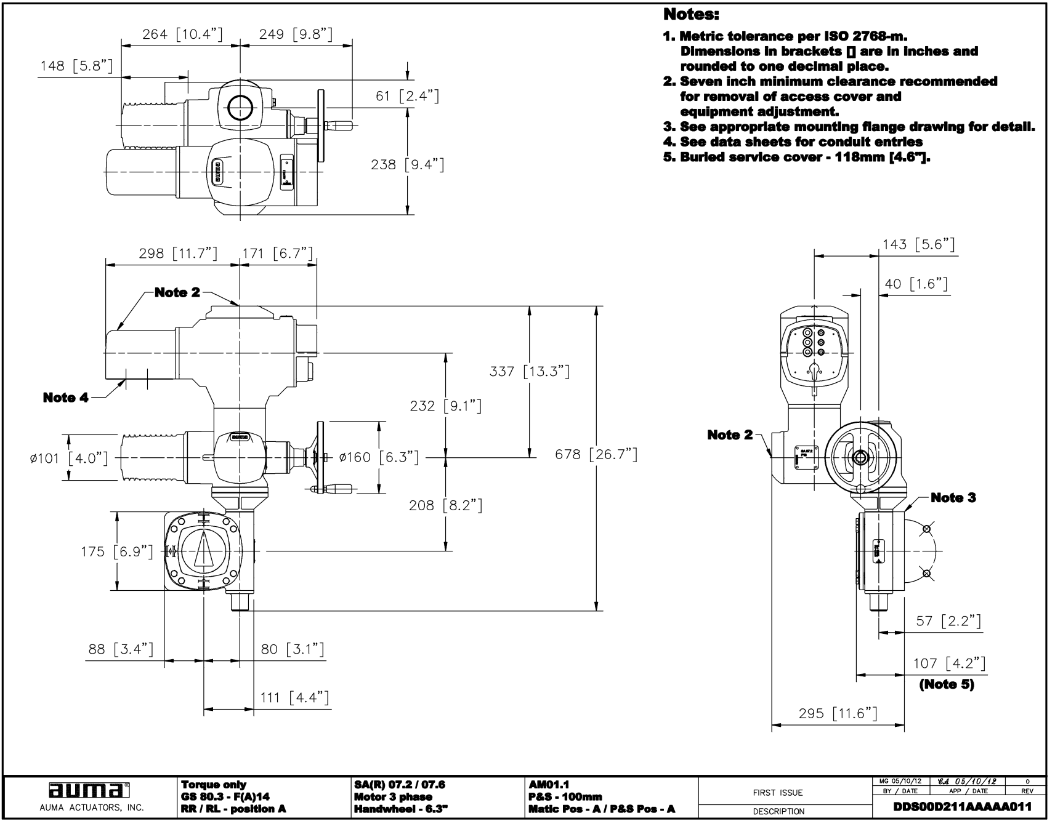
Typical DDS Dimensional Diagram

Slide 28
Diagram Availability
How can you access the diagrams?

Slide 29
Customer Order Diagrams
Drawing Submittal to the Customer
Wiring Schematic Diagram
Actuator Customer Cover
Wiring Schematic Diagram
Drawing vault
Wiring Schematic Diagram
Detailed Wiring Diagram

Slide 30
Internet
www.auma-usa.com
www.auma.com

Slide 31
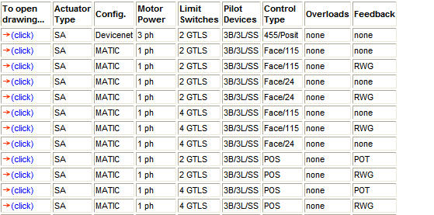
www.auma-usa.com
Go To :
      Support
      Sample wiring diagrams
The table is based on description:

Slide 32
www.auma-usa.com
Go To :
Customer Service
      Sales reps site
Log in using Username and Password
      Drawing Vault

Slide 33
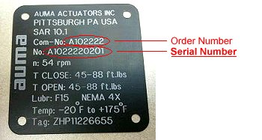
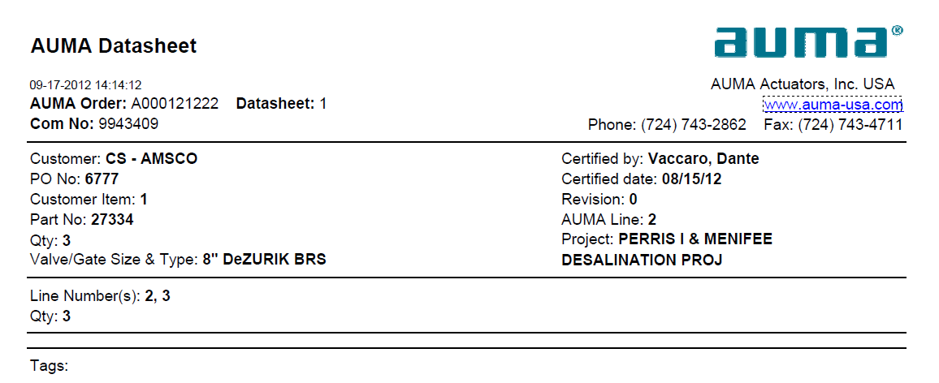
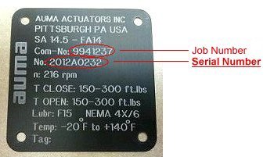
Updated Tagging Information
Pre November 2011
November 2011 and later
9941237
Additional information available at:
http://www.auma-usa.com/auma-new/FindSerial.html

Slide 34
Questions ???

